Slide 1
CHALLENGE 7 Infectious Swarm
Group 3
Aoshuang wang, lan yao, yixuan huang, lan luo

Slide 2




 | Lan Yao | Aoshuang Wang | Yixuan Huang | Lan Luo
Challenge 1 | Presenter
Challenge 2 |  |  | Presenter
Challenge 3 |  | Presenter
Challenge 4 |  |  |  | Presenter
Challenge 5 | Presenter
Challenge 6 |  |  | Presenter
Challenge 7 |  | Presenter
Challenge 8

Slide 3
 | Lan Yao | Aoshuang Wang | Yixuan Huang | Lan Luo
 | Program Writing | Program Writing &Debugging | Hardware Connection | Program Writing &Debugging

Slide 4
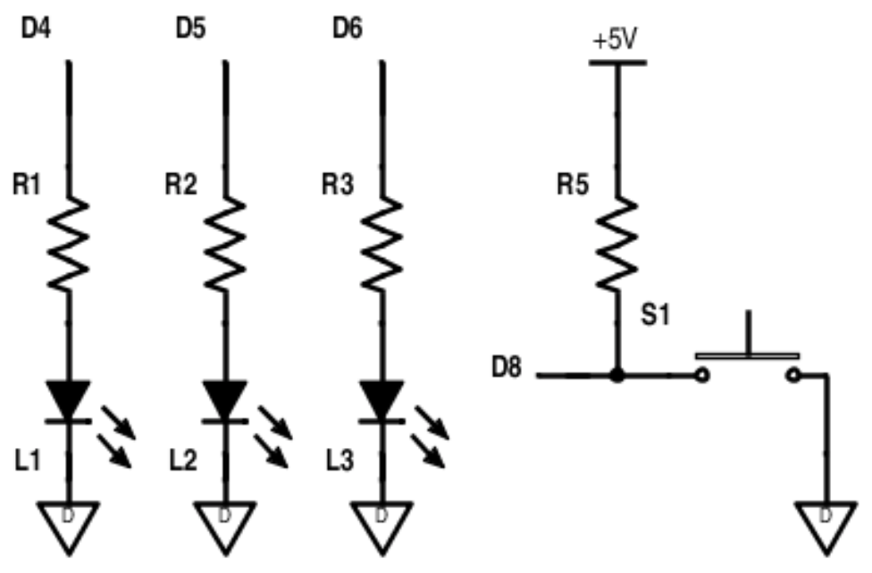
Pressing the button with either start an infection or clear an infection depending on being a leader or a non-leader .
One leader is elected on startup. A new leader is elected if an existing leader disappears.
While infected, each device will send out infection messages to other connected devices.
A clear infection message has priority over infection message.

Slide 5
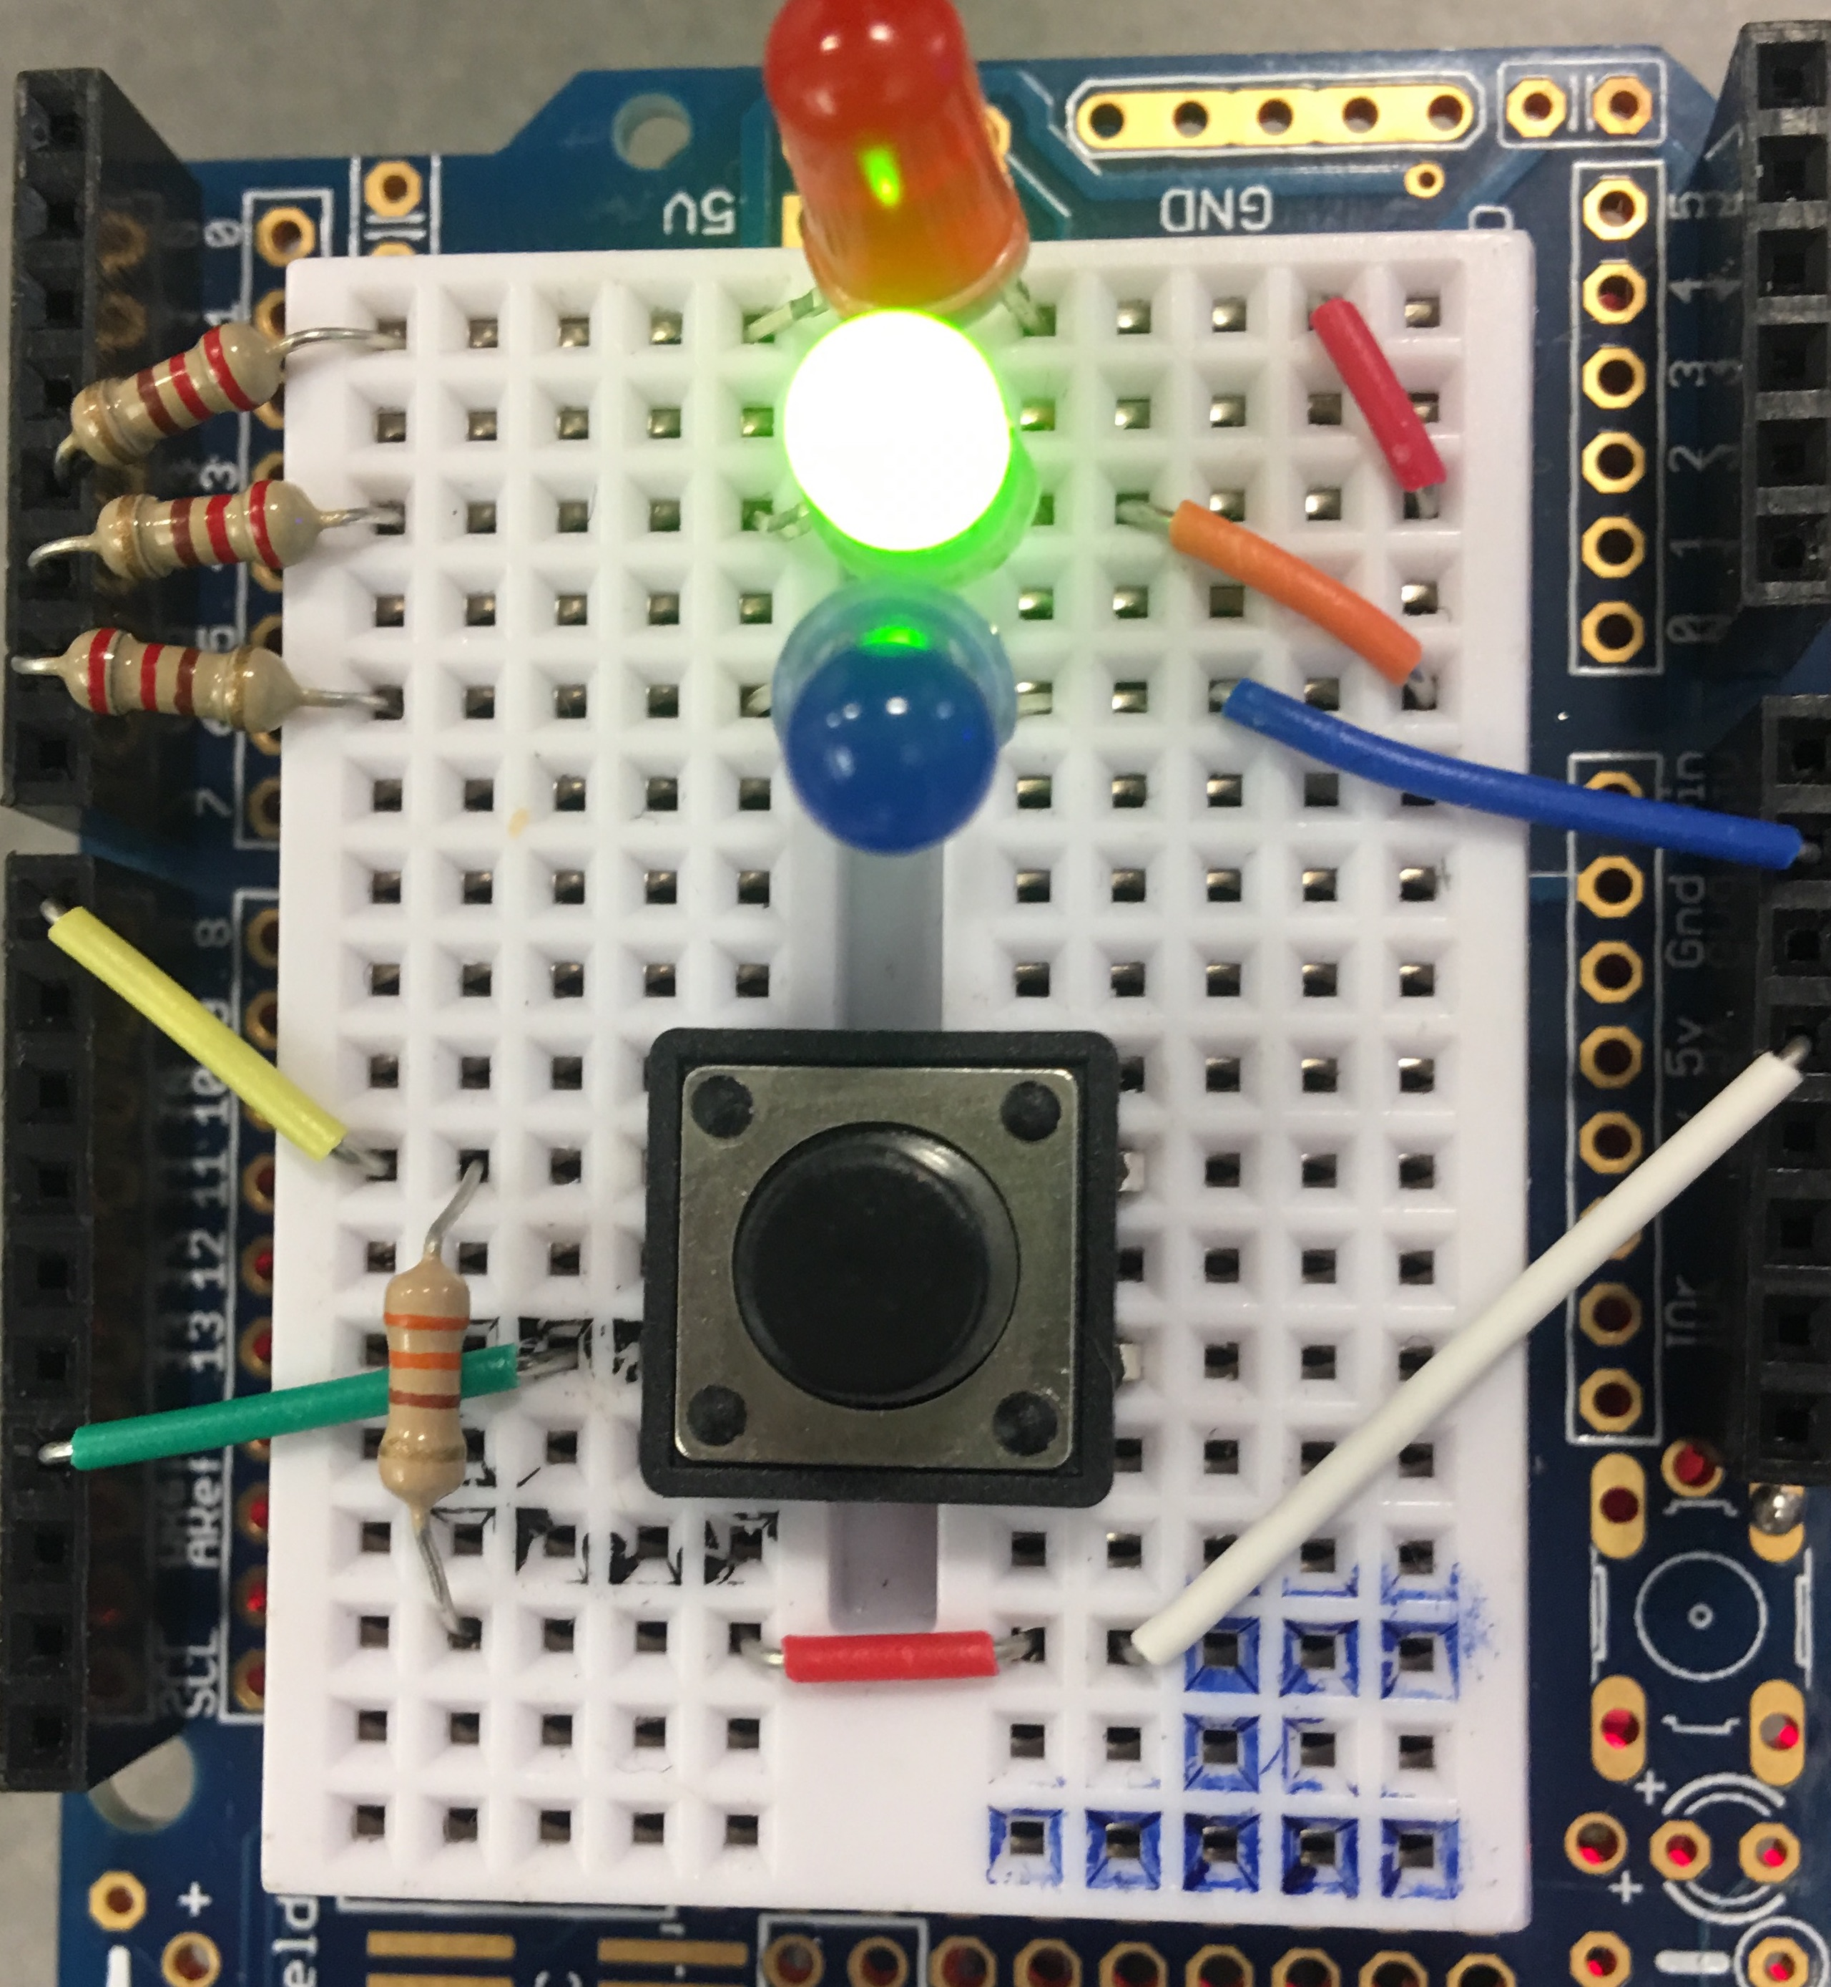
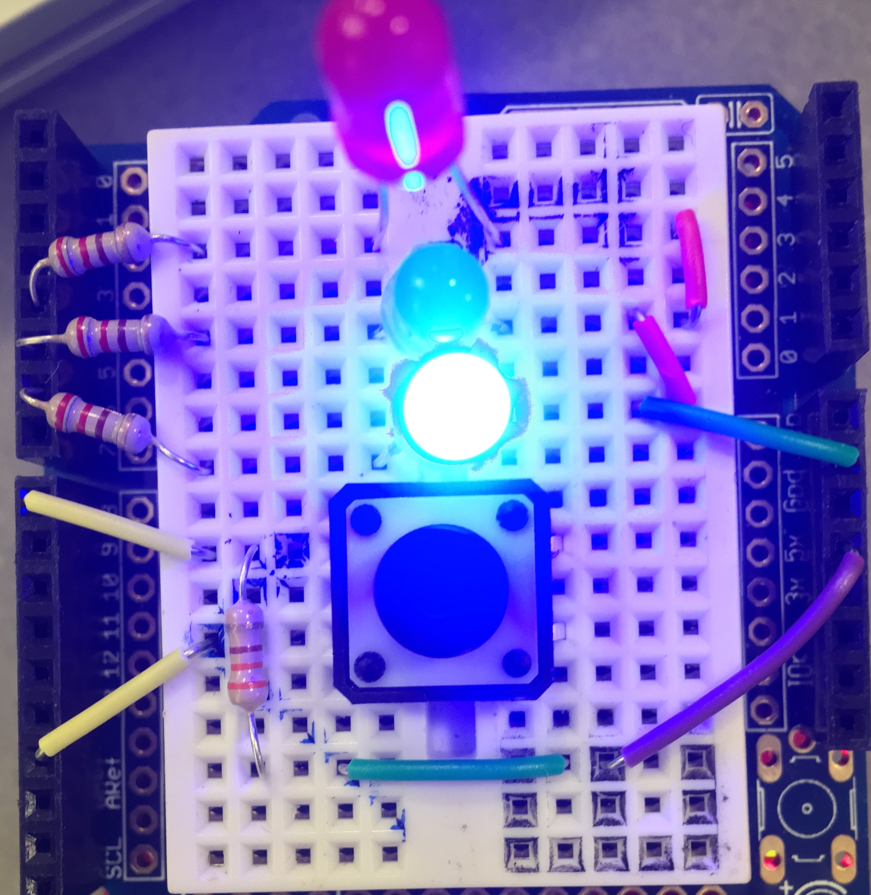
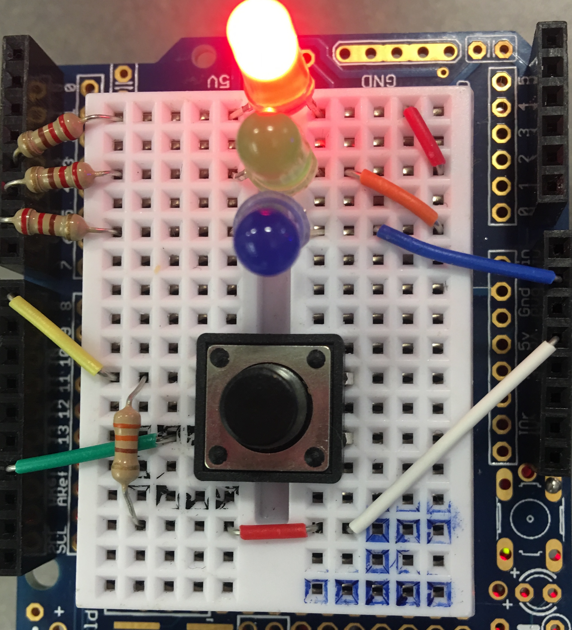
Green : uninfected
Blue : Leader
Red : Infected

Slide 6
For each Arduino
We tag every Arduino(XBee) with its serial address, which is unique to every Xbee.
Maintain a list of addresses of XBees that it can successfully hear from.
Whenever we add a few more new Xbees into the network, the election system can handle it by adding the address of new Xbees to the tail of the list.

Slide 7
For each Arduino - Messages in payload includes :
Discovery :
Happens when a device is just set up/join the network at the first time
Acknowledge :
Happens when my device received a message of “begin election” from other devices
Election :
Happens when I am the one who starts the election
Victory :
Happens when I have won this election
Heartbeat :
Happens when I am the leader and I have to tell others that I am alive
Clear :
Happens when I am the leader and my button has been pressed
Infection :
Happens when I am the non-leader and my button has been pressed

Slide 8
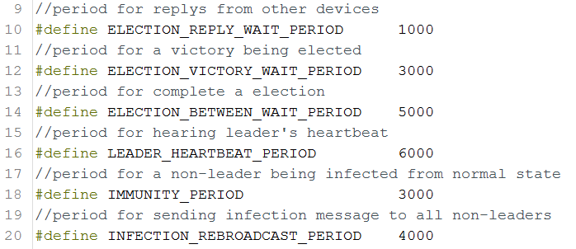
For each Arduino - Timers

Slide 9
Start
Setup
Diagram
Initial LED
Get My Address
leaderAddress=Myaddress
SendMessage: MSG_DISCOVERY

Slide 10
Read Pin Botton
Present State=Last State
TRUE
CLEAR INFECTION:
FALSE
Did Press The Botton&Botton State Changes
Break
TRUE
Botton State=LOW
TRUE
I am the leader
FALSE
isInfected=True
TRUE
isInfected=False
SendMessage: MSG_CLEAR

Slide 11
Read Packet(MSG_DISCOVERY)
Get Remote Address
Discovery:
Receive the packet we want
FALSE
TRUE
Leader Address=Remote Address
Ask for the correct message to be sent again
Leader Address<My Address
TRUE
Begin Election

Slide 12
Every Time Receive A New Packet:
Receive a new packet
inList=FALSE
Check if the device has already added into the device list
TRUE
FALSE
inList=TRUE
Add this device into device list
Continue

Slide 13
Function Start
Is electing now?
IsElecting=TRUE, isAcknowledge=FALSE, countdevice=0
Begin Election:
For all devices, is its address bigger than my address?
FALSE
TRUE
SendMessage: MSG_ELECTION to that device

Slide 14
Get message(MSG_ELECTION) from device A
SendMessage:MSG_ACK to device A
MSG_ELECTION
Device A get message(MSG_ACK) from that device
IsAcknowledege=TRUE
Variable isAcknowledge becomes TRUE only if one device is not the leader of the system, which means if we find isAcknowledge is FALSE in the main loop, this device should be the leader. Then it can send message MSG_VICTORY to every device.

Slide 15
MSG_VICTORY
Receive MSG_VICTORY
Remote Address> My Address?
FALSE
TRUE
Leader Address=Remote Address
Break
MSG_HEARTBEAT
Receive MSG_HEARTBEAT
TRUE
Remote Address > My Address
My Address=Leader Address
TRUE
FALSE
FALSE
Break
Leader Address=Remote Address

Slide 16
MSG_INFECTION
Receive MSG_INFECTION
Leader Address = My Address?
TRUE
FALSE
isInfected=TRUE
Break

Slide 17
Challenge
Use millis() for multitasking.
Learning about leader election algorithms.
Set up Xbee API firmware.
Election according to address.
Optimize delay.

